Slide 1




SAARTHI’26 Submission
Smart Cities & Public Safety
Team Leader Name: Adityakeerti
Team Member(s) Name: Arpan Singh , Adityakeerti ,Megha Singh, Aviral Mittal
College Name: Graphic Era Hill University , Dehradun , Uttarakhand
Team Name

Slide 2



Problem Statement
Problem Statement:
  Indian cities make decisions every day: road projects, diversions, scheme rollouts, civic complaints. Citizens rarely understand them. Information sits in formal notices and portals, there is no native-language way to ask, report or opine, and departments work in silos. Authorities cannot answer queries at scale, while services like traffic control and emergency response still run on static, disconnected systems. The result is a trust gap between citizens, businesses and government.
Detailed description about the problem:
Information gap: schemes and local projects are poorly explained, with little native-language support.
No two-way channel: citizens cannot question, report or give opinions in a structured way.
Silos: complaints, projects and services sit with separate departments, with no unified citizen-facing layer.
Static services: for example, fixed-timer signals and no automated emergency priority delay response when it matters most.
Evidence slot: add cited sources on language access, civic-grievance volumes and urban service delays. The PDFs hold no verified figures, so none are invented here.
Team Name
2

Slide 3

Proposed Solution
Solution Statement:
  NagarSaarthi is a smart-city communication and coordination platform. Verified authority avatars speak to citizens in their own language, explaining schemes, projects and policies, hosting AI townhalls and answering from official records through RAG. Citizens report issues with text, photo or video, and the platform routes them to the right department. Geo-fenced alerts explain what is being built or changed nearby. City modules plug into the same layer; our flagship module, AI traffic and emergency green corridors, turns live signal and incident data into alerts and explanations.
  “Building smarter, safer, more sustainable cities through intelligent mobility and transparent, citizen-centric governance.”
Detailed Solution description:
Verified authority avatars: 3D avatars for leaders and departments, answering in multiple Indian languages via Sarvam speech and translation.
AI townhalls: live Q&A and policy explanation, with citizen opinions captured and summarised for the authority.
Geo-fenced civic awareness: nearby ongoing projects, closures and policies explained in context.
RAG over verified sources: notices, scheme documents and live updates, with source citations in every answer.
Flagship module: Mobility and Emergency (built from the traffic work)
Grid-occupancy vision and RL signal control, green corridors for ambulances, accident detection and rerouting. Its events flow into the core as alerts that avatars explain.
Pluggable modules (roadmap, label as such)
Sanitation and waste, water and utilities, streetlights and public works, air quality. All reuse the same complaint, geo-fence and avatar pipeline. Don’t claim these as built.
Differentiators: one citizen interface for many departments, native-language access, verified identity, and transparency through cited answers.
Team Name
3

Slide 4


Technical Approach
Technologies To Be Used:
Onboard: authority verification, avatar creation (3D for authorities, lightweight identity for citizens).
Ingest: official notices, scheme documents and project data → chunk → embed → knowledge base.
Ask or report: citizen speaks, types or uploads → Sarvam ASR/translation → intent (query / complaint / feedback).
Retrieve and respond: RAG → grounded answer with citation → translate → TTS → avatar lip-sync.
Route: complaints go to department queue plus authority dashboard; unanswerable queries escalate to a human.
Trigger: geo-fence or city event (project, closure, emergency) → contextual alert plus avatar explanation.
Design rule: the LLM only answers from retrieved official sources and never controls infrastructure. City-control modules, such as signals, run on deterministic or RL logic with fail- safe fallback.
4
Team Name

Slide 5

Detailed Description:
Layer | Choice
Frontend | React Native (citizen and authority apps), Next.js (authority dashboard)
Backend | FastAPI, REST + WebSockets
Voice and language | Sarvam AI: speech-to-text, translation, text-to-speech, across Indian languages
LLM and RAG | LLM for grounded response generation, LlamaIndex for ingestion and retrieval
Data | PostgreSQL + PostGIS (geo-fencing, complaints) + pgvector (embeddings)
Maps | OpenStreetMap + MapLibre
Avatars | Lightweight glTF/GLB avatars in WebGL with viseme lip-sync (a self-hosted or open pipeline; verify its licence)
Complaint intake | Image/video classification for routing (CV model), department routing rules
Identity | Verified authority onboarding with a signed-identity badge on every avatar
Infra | Docker Compose for the demo, Kubernetes on AWS/GCP as the scale path
5
Team Name

Slide 6



Impact and Benefits
Impact Metric | Details
Social Impact | Improves access to government schemes through multilingual AI avatars. Enables citizens to report civic issues, receive verified information, and engage with local authorities. Improves emergency response and public safety.
Economic Impact | Reduces fuel wastage and time lost in traffic congestion. Improves transport efficiency, supports local businesses, and helps emergency services reach destinations faster. Better visibility of businesses and government initiatives.
Environmental Impact | Reduces vehicle idling, fuel consumption, and associated emissions through adaptive traffic signals and intelligent route optimization.
Target Audience | Urban citizens, commuters, ambulance and fire services, municipal authorities, traffic police, local businesses, and city administrators.
6
Team Name

Slide 7


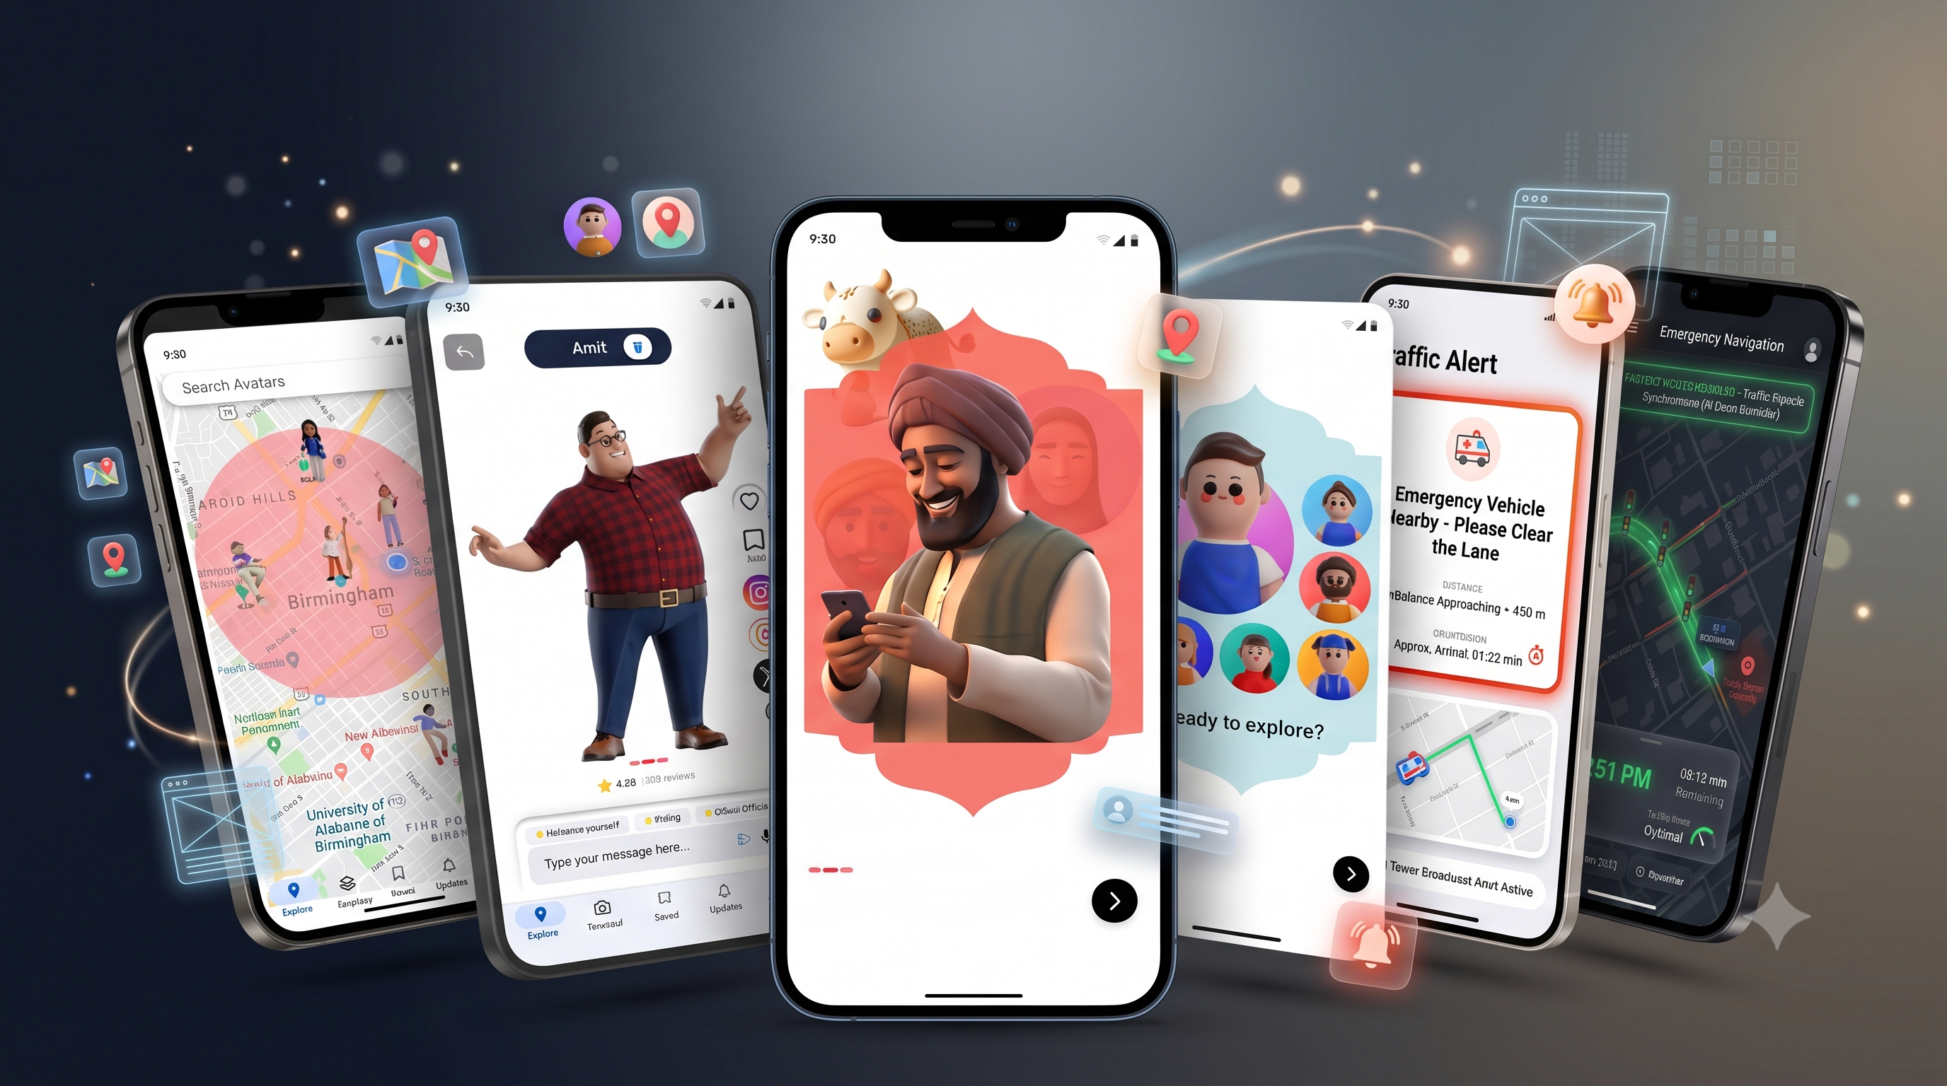
Prototype
Team Name
7

Slide 8


Research & References
Research Work:
Research basis (how each source is used):
[1] Wei et al., PressLight: Learning Max Pressure Control to Coordinate Traffic Signals in Arterial Network, KDD 2019. Basis for our RL signal-control design and baseline.
[2] Traffic Signal Control With Deep Reinforcement Learning (IEEE 8054579). DQN-based signal control.
[3] Deep Reinforcement Learning for Traffic Light Control in Vehicular Networks (IEEE 9098073). RL in connected-vehicle settings.
[4] Lopez et al., Microscopic Traffic Simulation using SUMO, ITSC 2018. Simulation environment for training and benchmarking.
[5] Lewis et al., Retrieval-Augmented Generation for Knowledge-Intensive NLP Tasks, NeurIPS 2020. Foundation for grounded, citable avatar answers.
[6] RAG avatar memory paper (ScienceDirect, S2666188825006586). Avatar memory design.
[7] Constitution of India, Eighth Schedule. Scope of language support (22 scheduled languages).
Links:
Sarvam AI docs: https://docs.sarvam.ai/sarvam-api-docs
SUMO: https://www.eclipse.org/sumo/
Ultralytics YOLO: https://github.com/ultralytics/ultralytics
RAG paper: https://arxiv.org/abs/2005.11401
PressLight: https://dl.acm.org/doi/10.1145/3292500.3330949
IEEE 8054579: https://ieeexplore.ieee.org/document/8054579
IEEE 9098073: https://ieeexplore.ieee.org/document/9098073
OpenStreetMap: use the OSM wiki or Overpass API page you actually call, not taginfo.
Team Name
8

Slide 9


Instructions for Submission
  Maximum Slides:
Up to 8 slides (including title slide).
  Design:
Use diagrams, points, and visuals to make the presentation concise and engaging.
  Format:
Save the presentation as a PDF before submitting.
Team Name

